Slide 1
Language Detection Web Application
Using NLP
Contributors:
Md. Masum Billah
Sakib Alam Snigdha
Supervisor:
Enamul Hassan

Slide 2
Outline
Why NLP
Text Pre-processing
Vectorization
Processing Datasets
Training Model
Model Evaluation
Frontend Application
Results & Findings
End Note

Slide 3
Why NLP?
Language is one of the defining characteristics of our species
NLP helps to resolve ambiguity in language and adds useful numeric
structure to the data
A large corpus of knowledge can be organized and easily accessed using NLP

Slide 4
Text Preprocessing
Tokenization
Stop words Removal
Lower case conversion
Removing numeric/digits
Removing Punctuations/Special Characters
Removing characters (for foreign languages)
Normalization

Slide 5
Text Preprocessing
Remove punctuations
! " # $ % & ' ( ) * + , - . / : ; < = > ? @ [ \ ] ^ _ ` { | } ~
Remove line breaks, empty spaces
Hello ↵World -> Hello World
Transform to lowercase
Hello World -> hello world

Slide 6
Vectorization
TF-IDF
TF-IDF creates vectors from text which contains information on the more important words and the less important words as well.
Algorithm:
tf idf (t, d, D) = tf (t, d) . Idf(t,D)
Where,
tf = term frequency
idf = inverse document frequency
t = word
d = document
D = set of documents

Slide 7
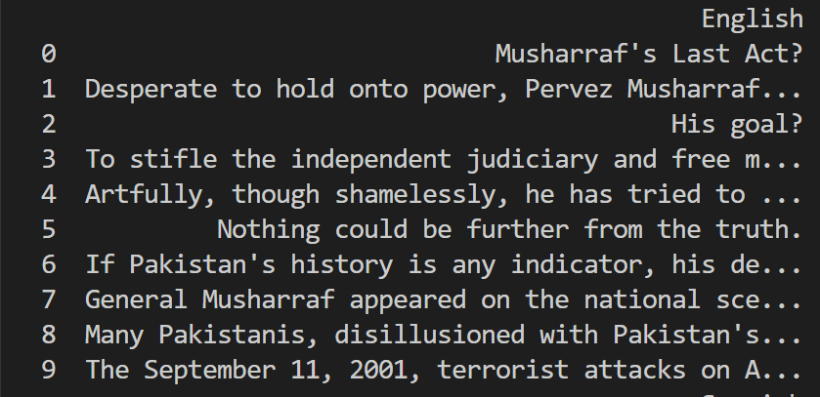
Processing Datasets
English Data
Total number of data: 1,80,657

Slide 8
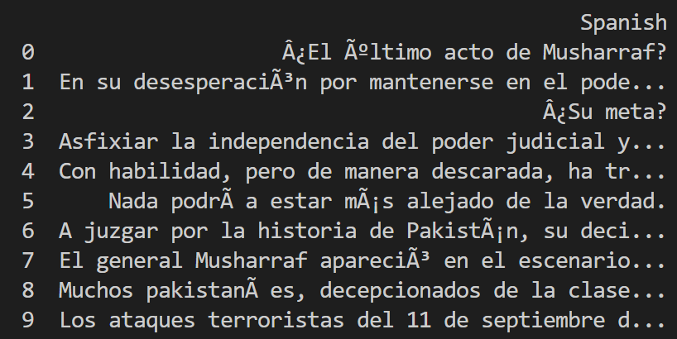
Processing Datasets
Spanish Data
Total number of data: 1,59,260

Slide 9
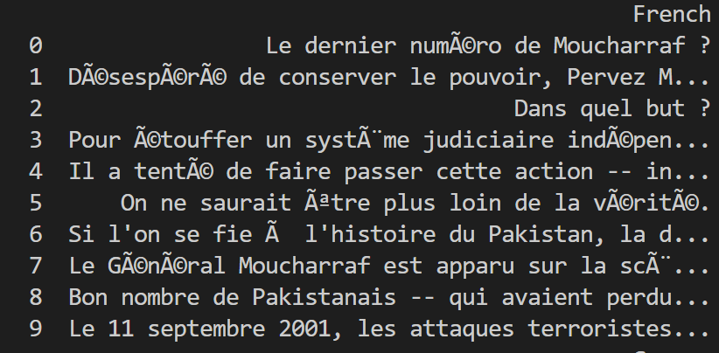
Processing Datasets
French Data
Total number of data: 1,47,251

Slide 10
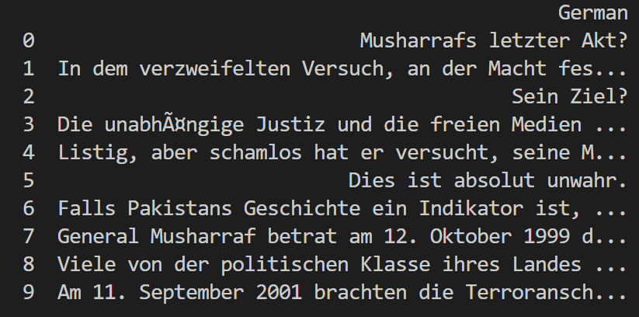
Processing Datasets
German Data
Total number of data: 1,61,805

Slide 11
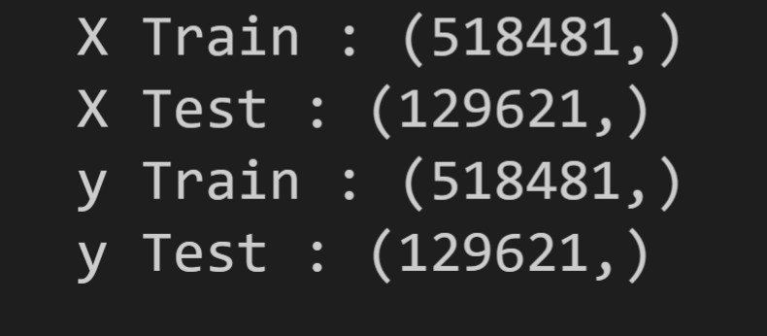
Training Model
Splitting Data into Train and Test sets
80:20 (Train : Test)

Slide 12
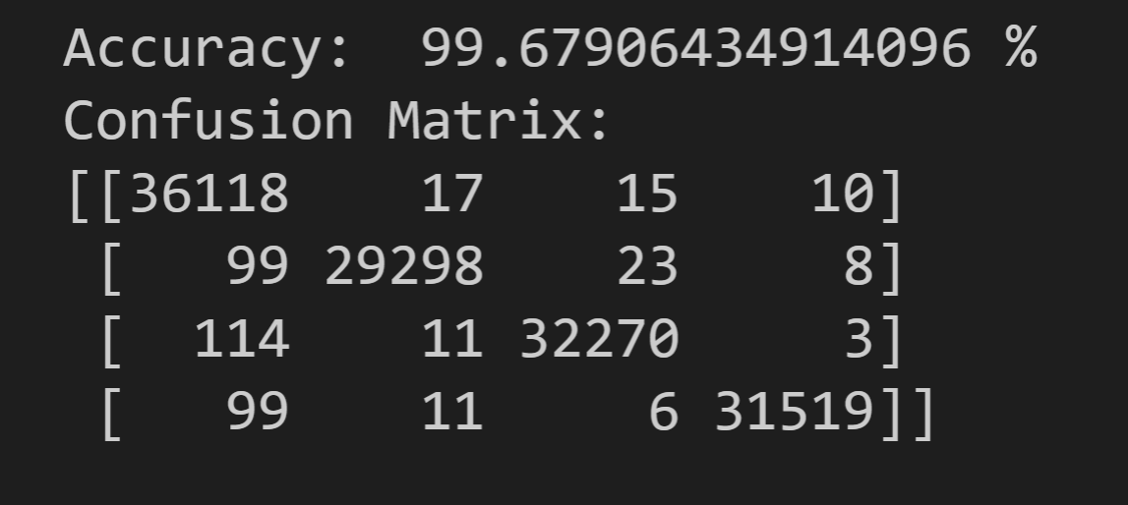
Model Evaluation
Accuracy & Confusion Matrix

Slide 13
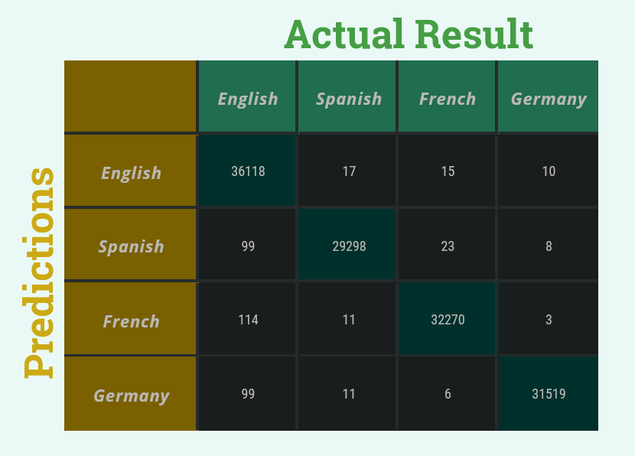
Model Evaluation
Confusion Matrix

Slide 14
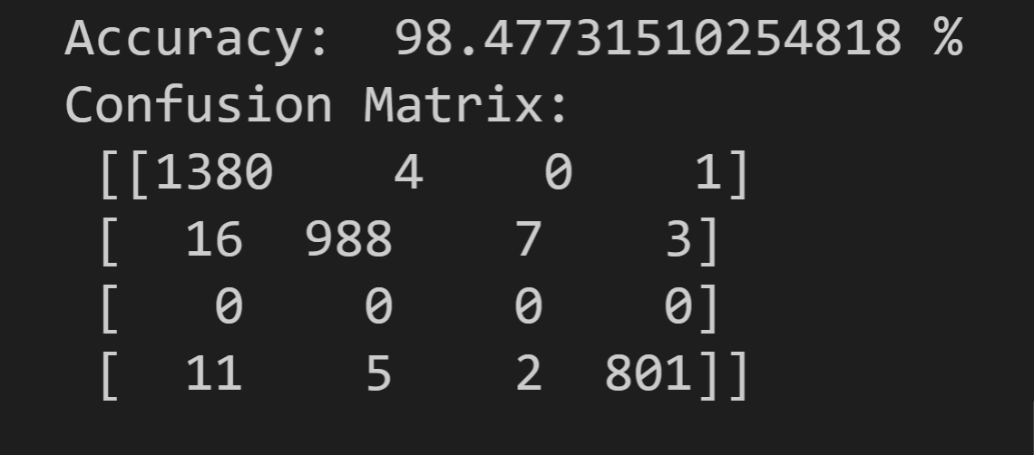
Model Evaluation
Accuracy & Confusion Matrix with Separate Dataset
On Trained Model

Slide 15
Model Evaluation
Prediction
It is raining today.
English
Il pleut aujourd'hui.
French
Es regnet heute.
German
Hoy esta lloviendo.
Spanish

Slide 16
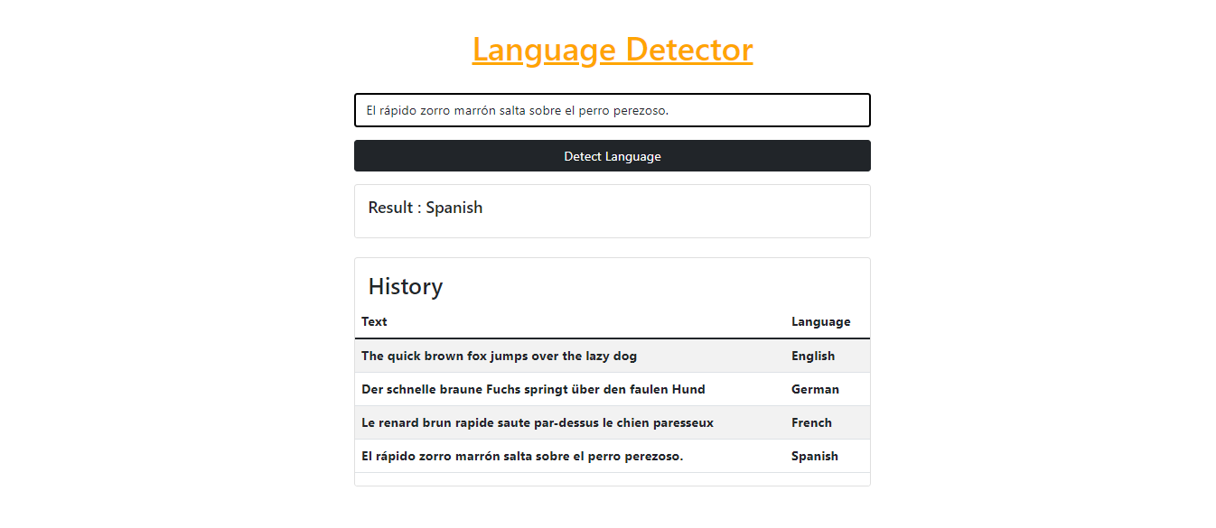
Frontend Application

Slide 17
Result & Findings
99.67% accuracy proved that the model is successful on determining language of English, German, French and Spanish.
As per the accuracy on the testing dataset the model is 1.2% overfitting.
The web application is very responsive.
Further development of this project will enhance the performance and adding more languages in the future.

Slide 18
Thank you

